Slide 1
Let’s PowerBI

Slide 2



TJay Belt
Database Administrator at Nature Sunshine
eMail me TJayBelt@yahoo.com
Read me http://tjaybelt.blogspot.com
Follow me @tjaybelt

Slide 3









Thank the sponsors!!
Global Partner
Gold
Silver
Bronze
Pass
Venue

Slide 4

Can I use PowerBI?

Slide 5

DBA Task List

Slide 6
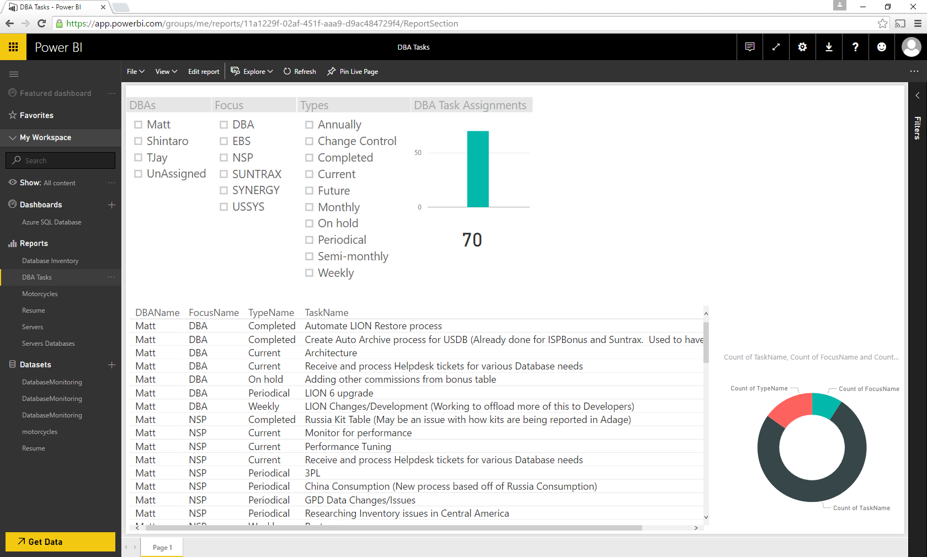

Slide 7

Family Movies?

Slide 8
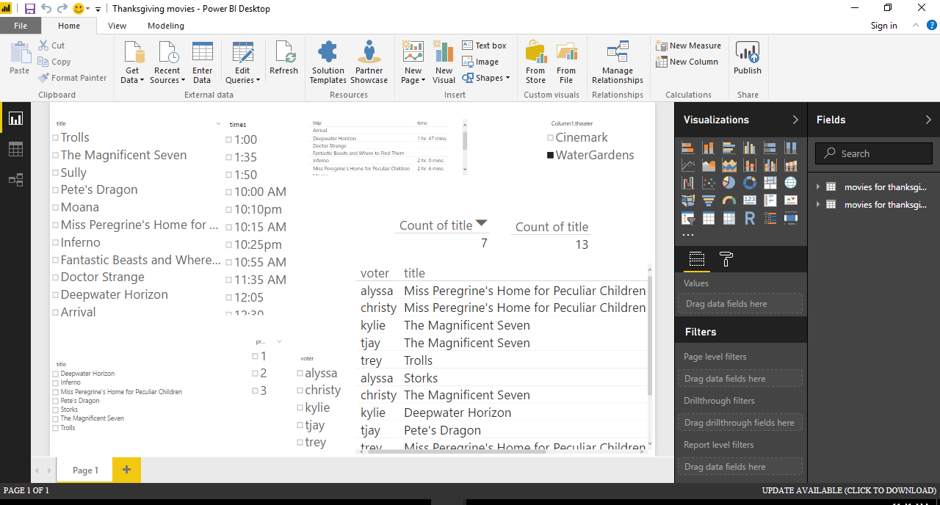

Slide 9

Speaker Contributions

Slide 10
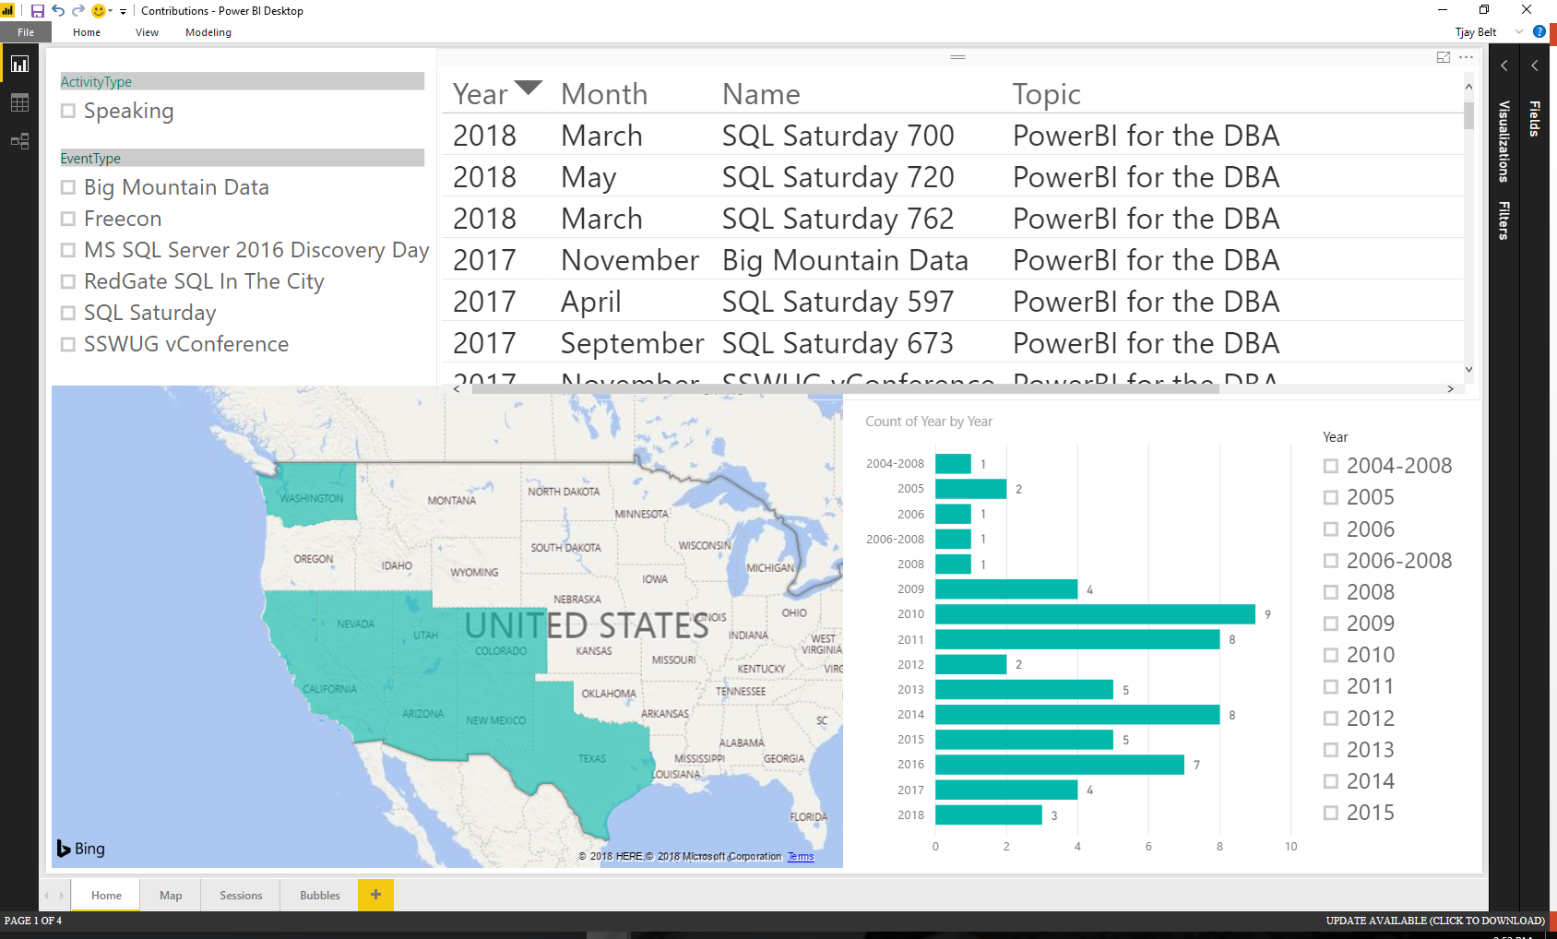

Slide 11

My Resume

Slide 12
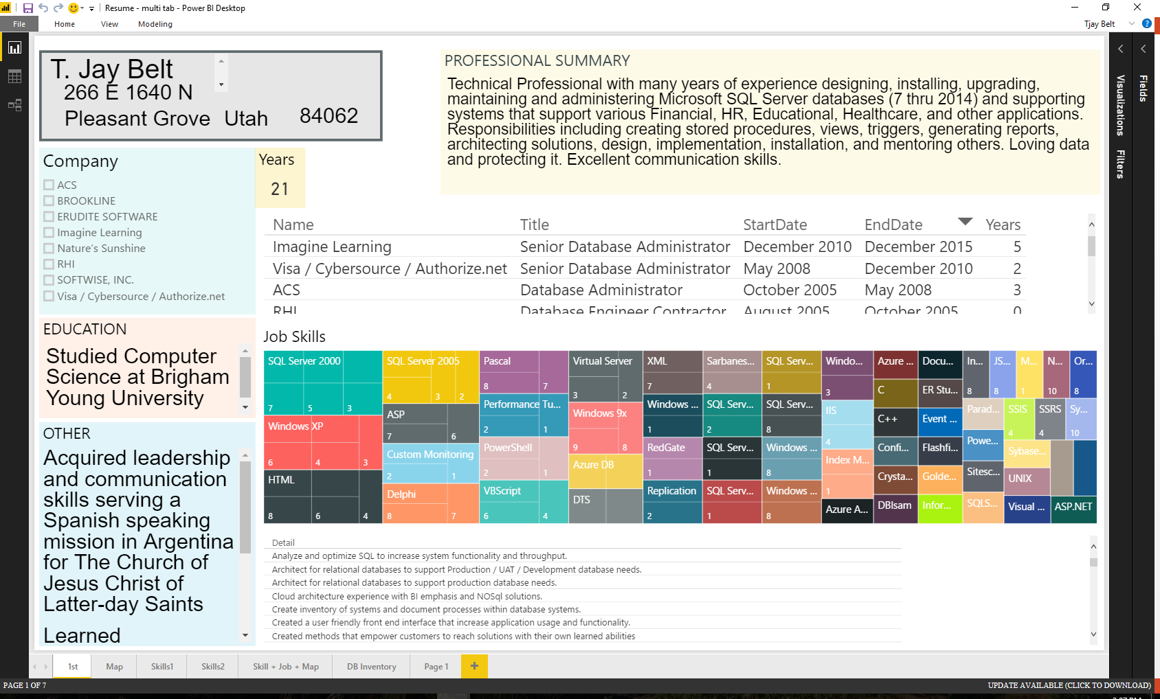

Slide 13
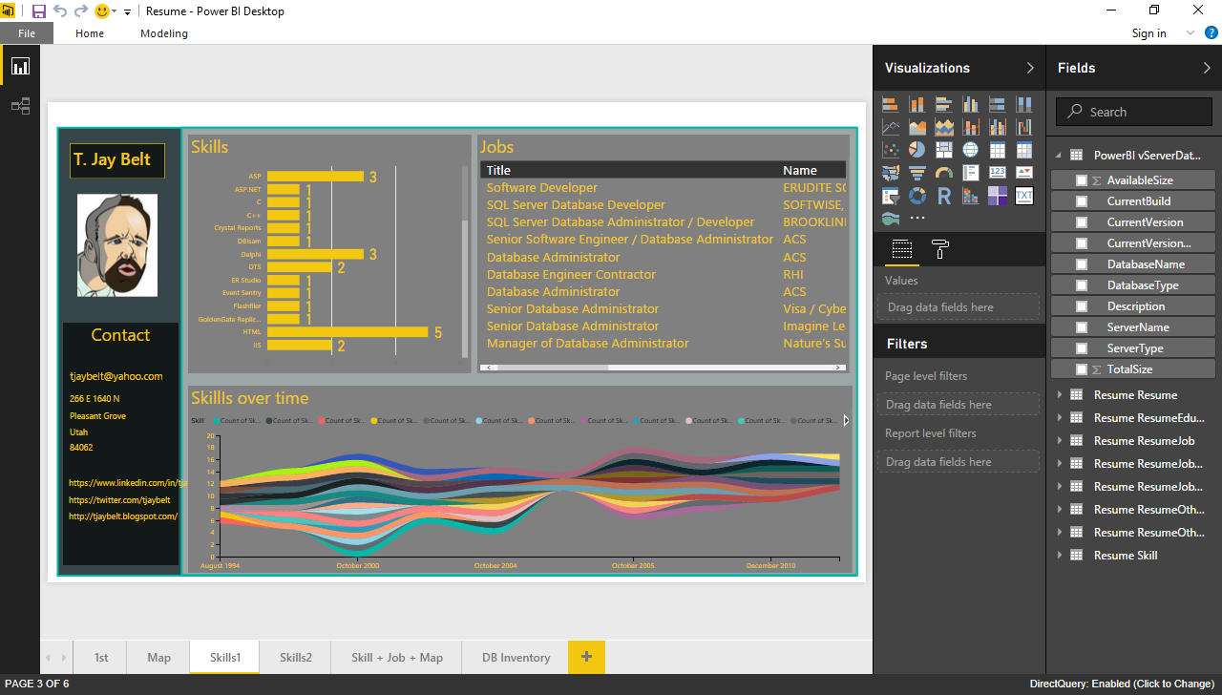

Slide 14
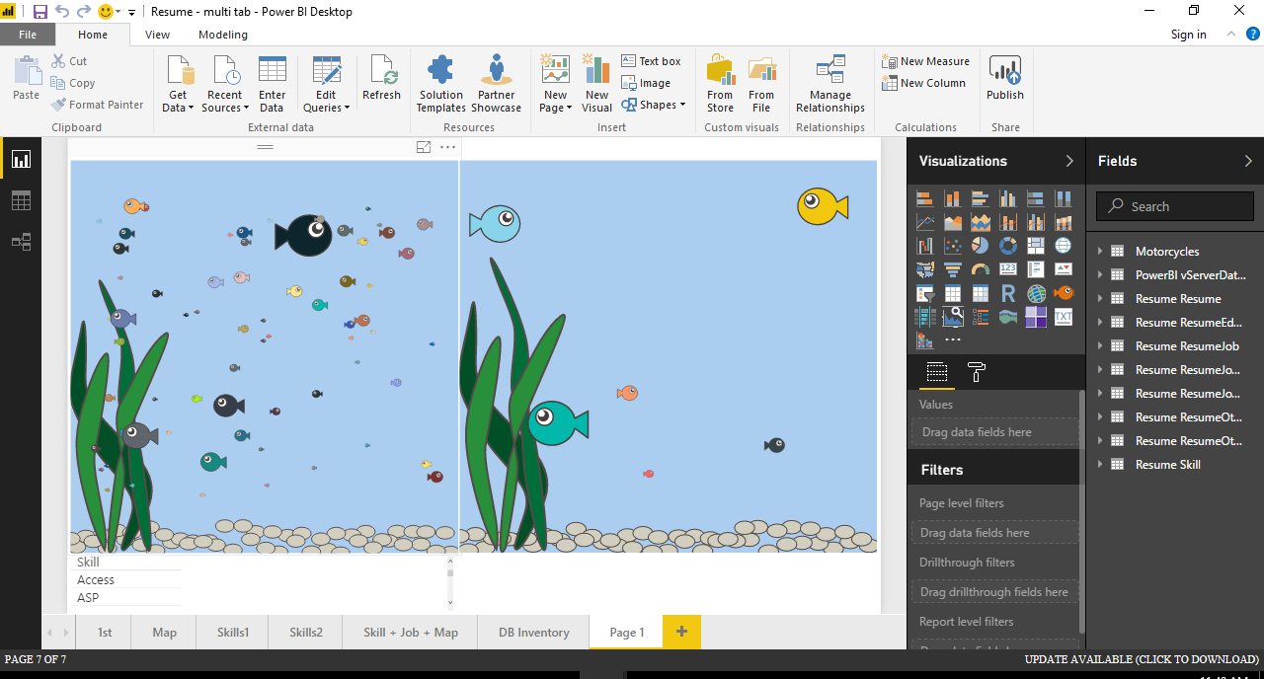

Slide 15

DBA tasks
Get Data File Size
DB Inventory
SLA Meetings
Server Database Detail
DDL Events

Slide 16
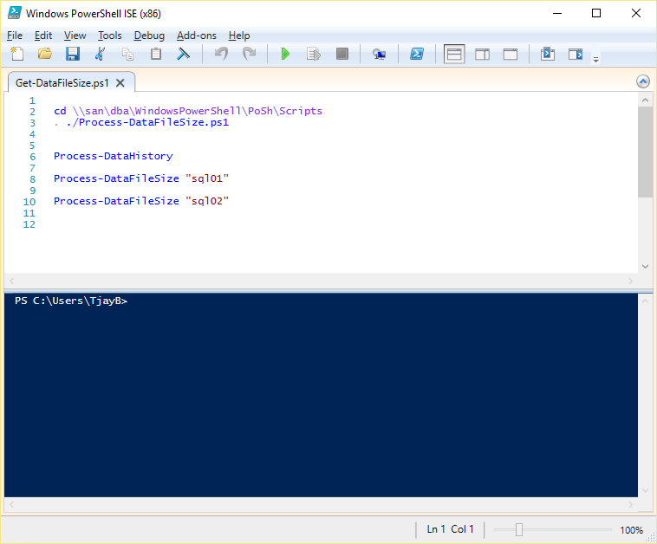

Slide 17
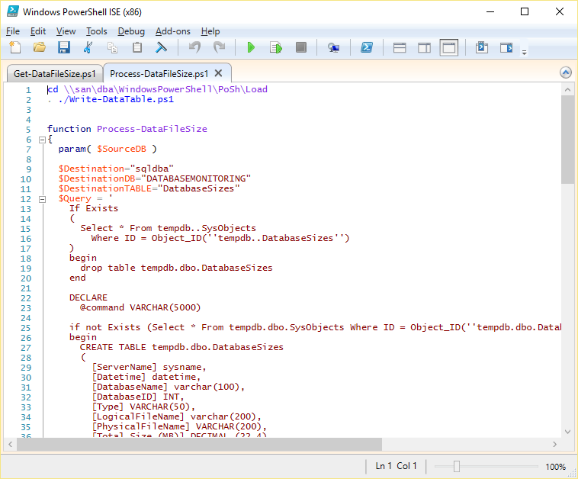

Slide 18
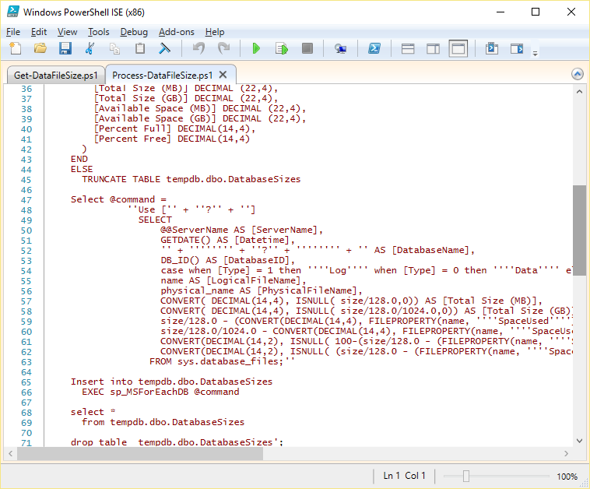

Slide 19
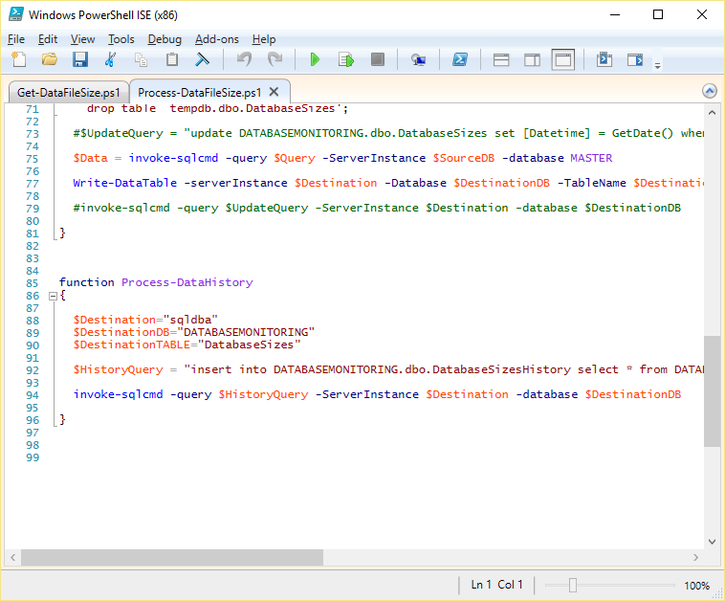

Slide 20
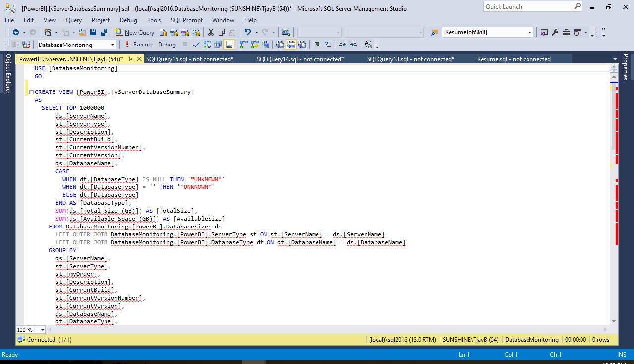

Slide 21
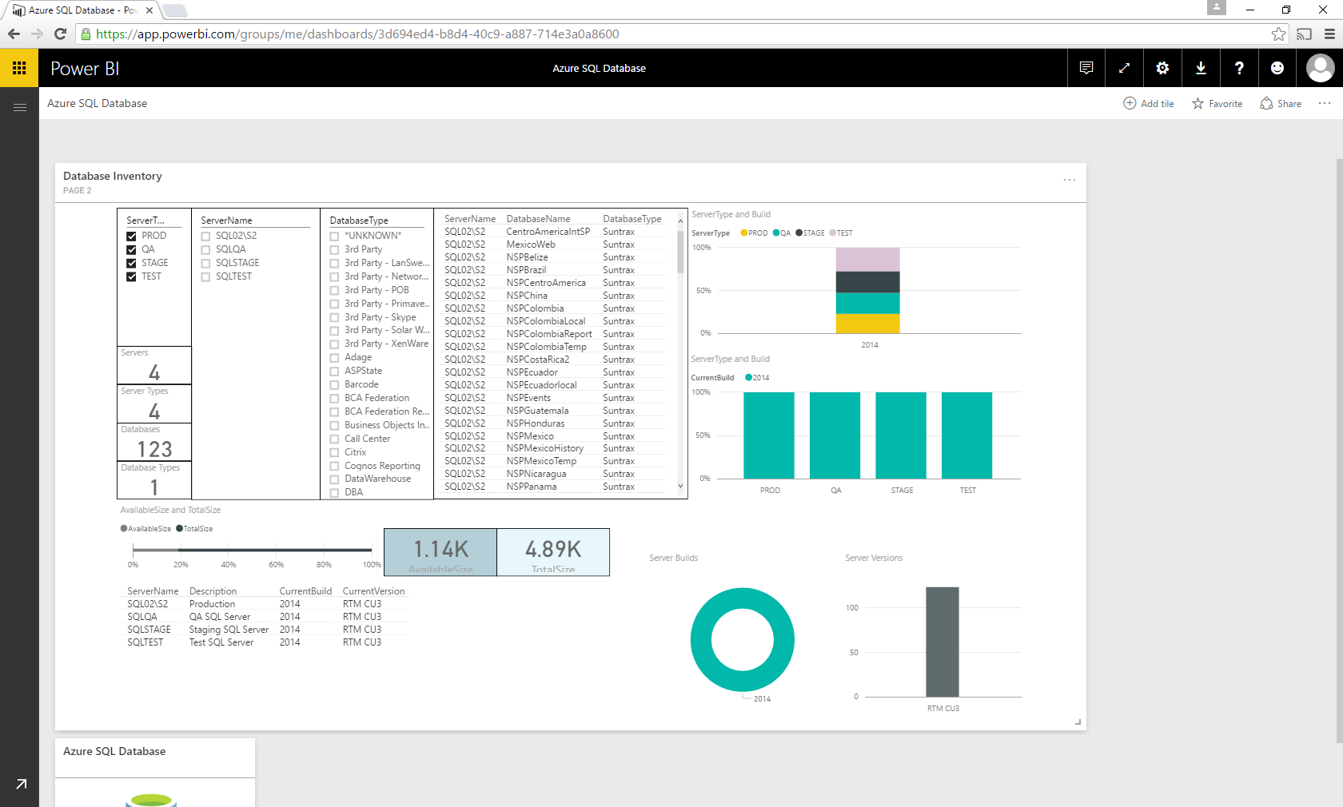

Slide 22

SLA Meeting

Slide 23
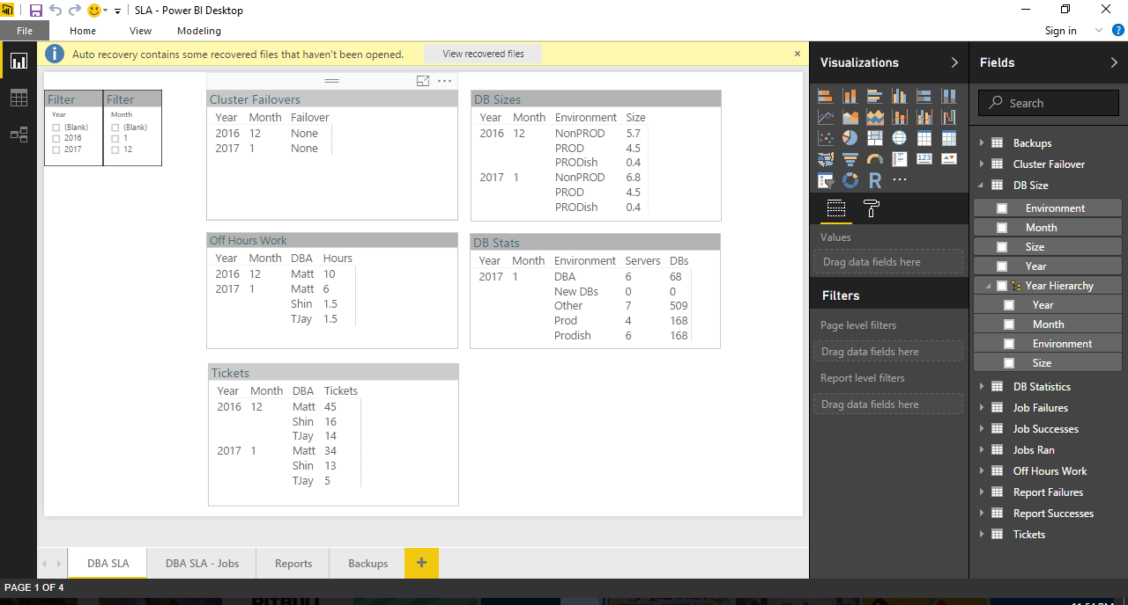

Slide 24

SLA Meeting - Cluster Failovers

Slide 25
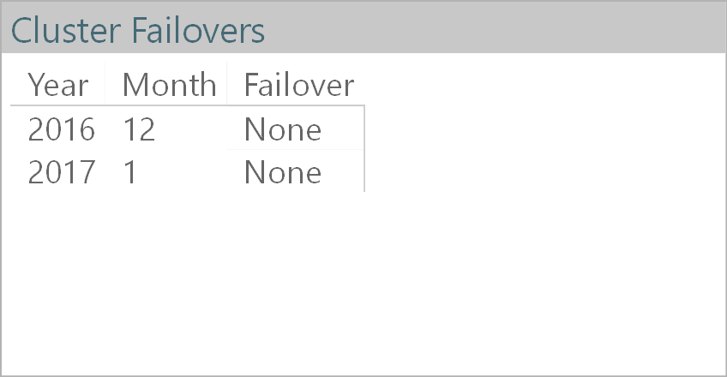

Slide 26
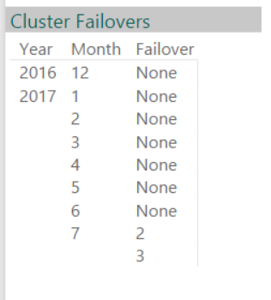

Slide 27
SLA Meeting - Cluster Failovers became Uptime

Slide 28
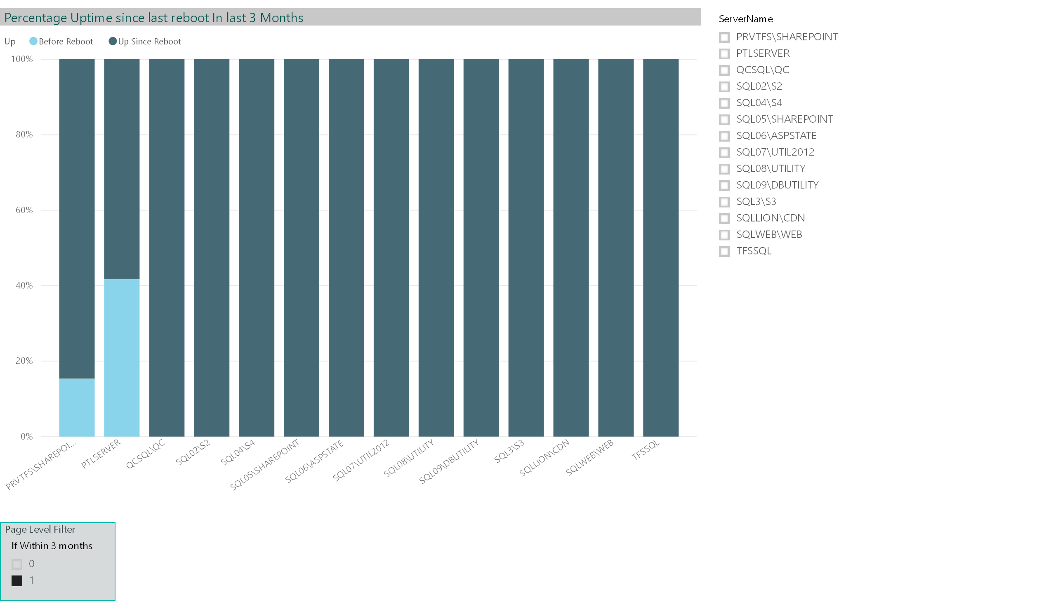

Slide 29
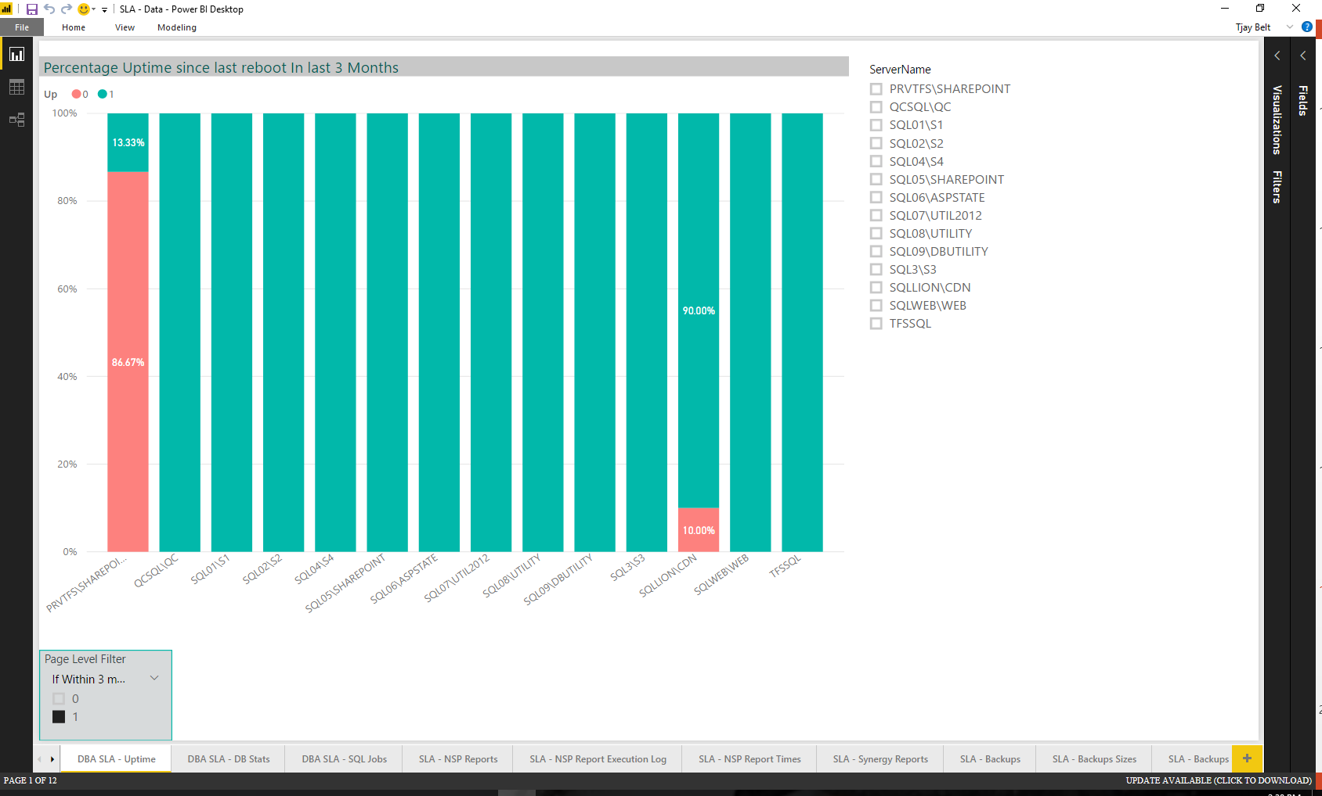
DBA SLA

Slide 30
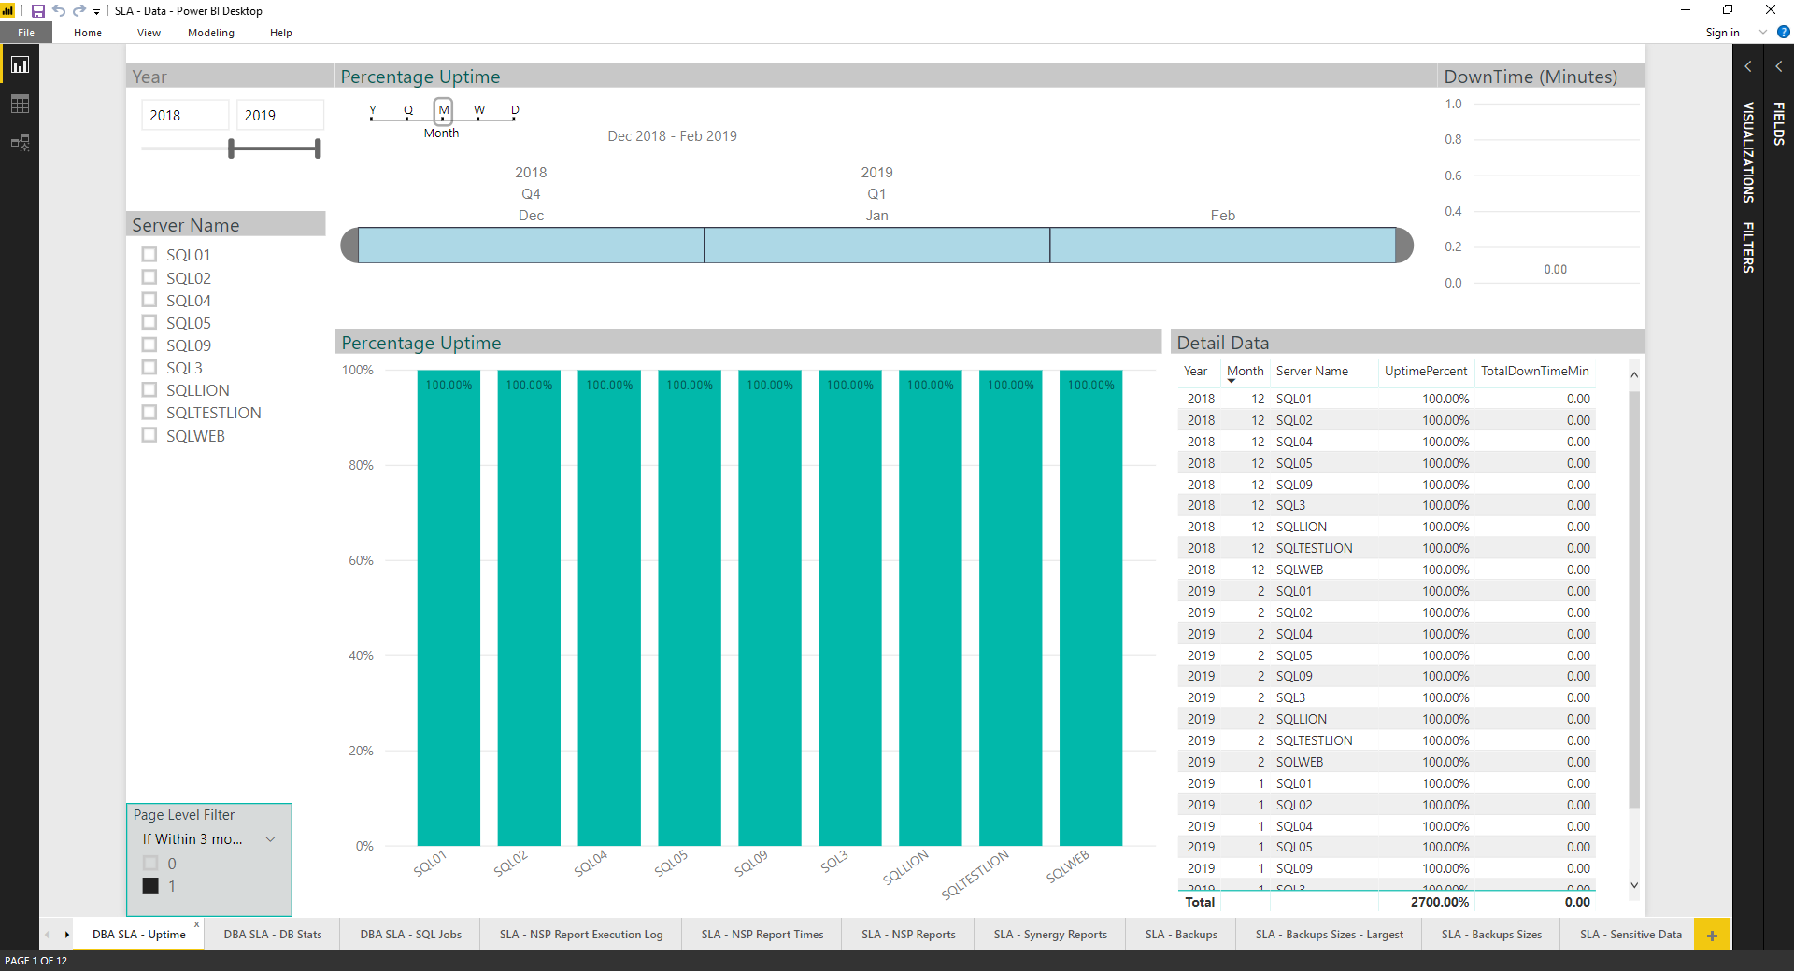

Slide 31

SLA Meeting - Database Counts and Sizes

Slide 32
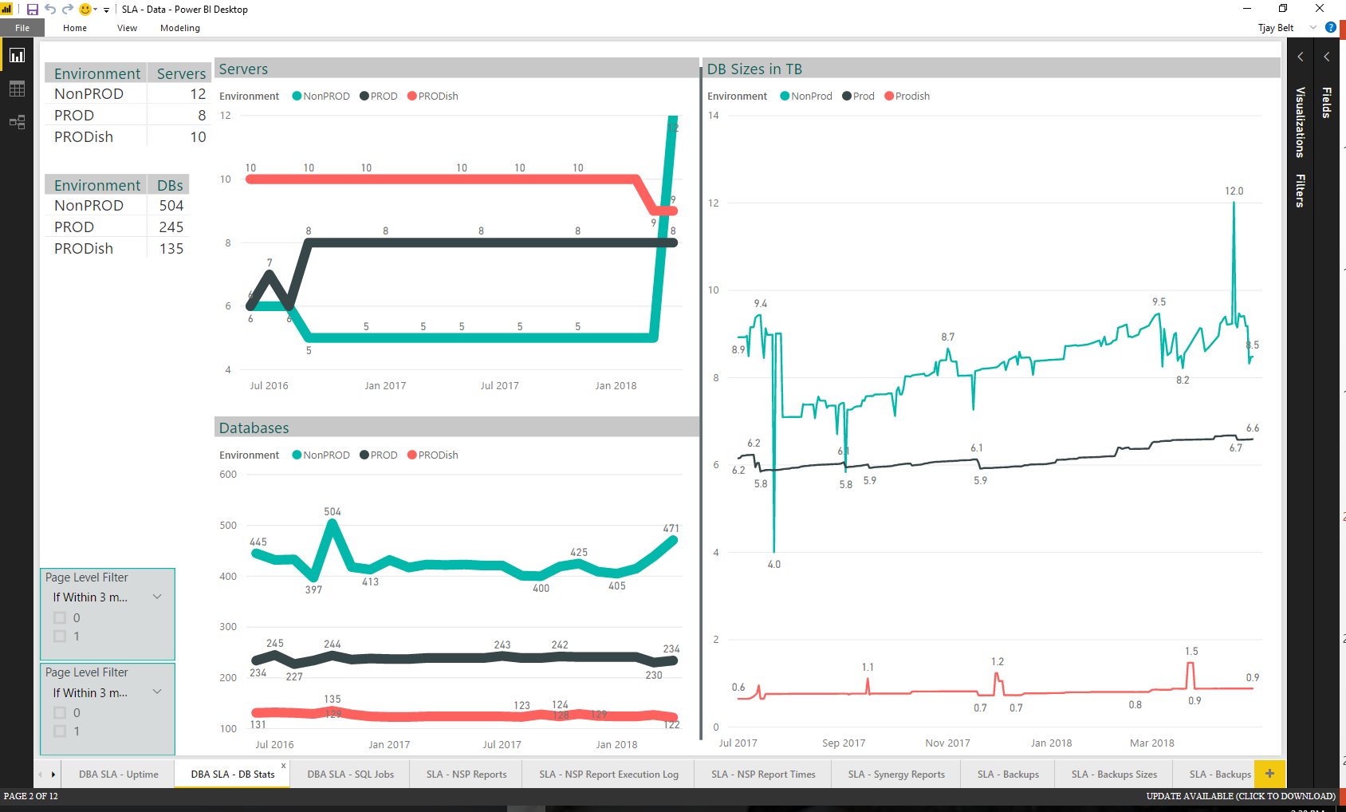
DBA SLA

Slide 33

SLA Meeting - Jobs Ran

Slide 34
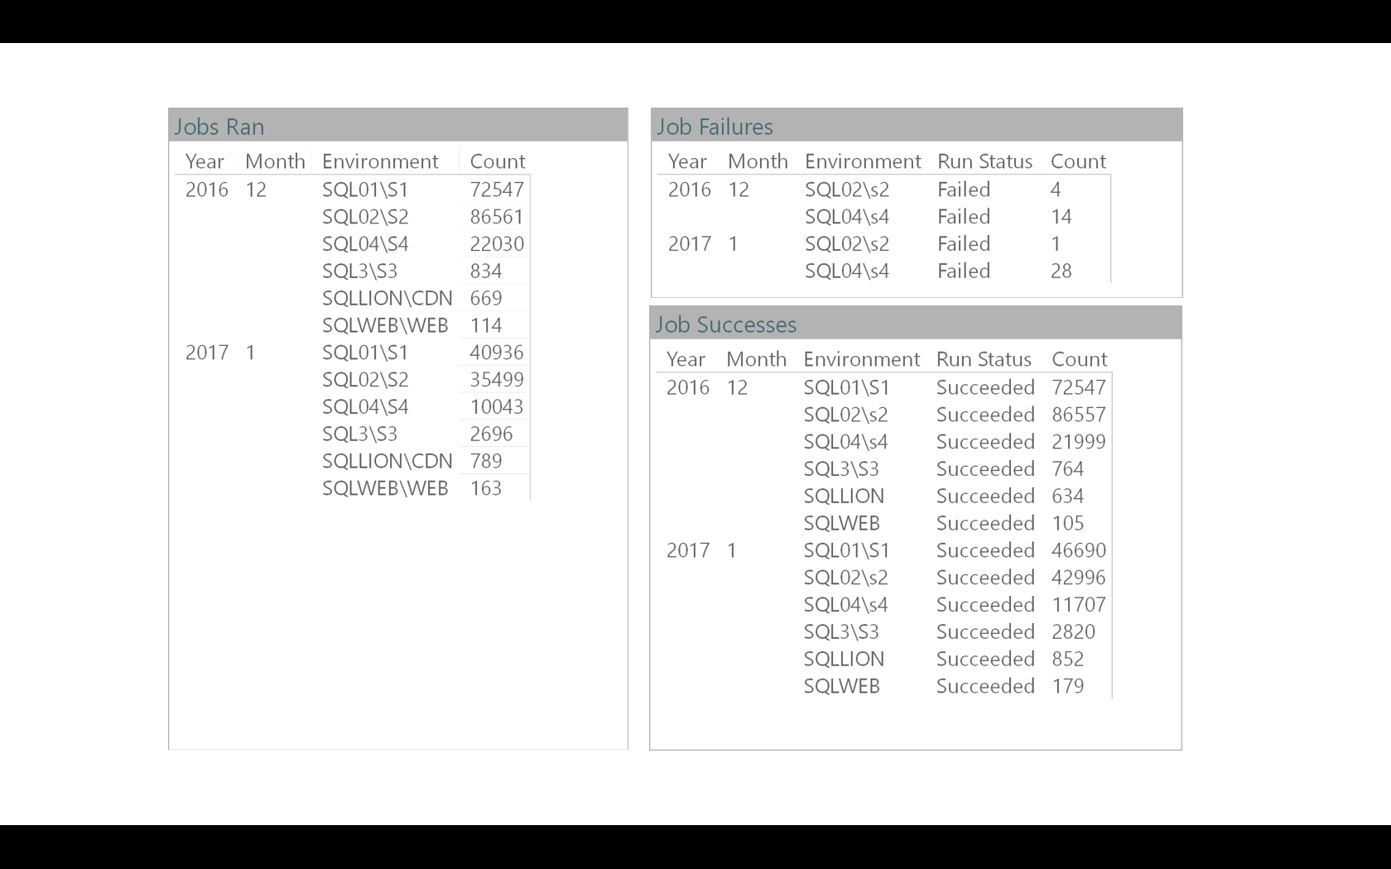
DBA SLA

Slide 35
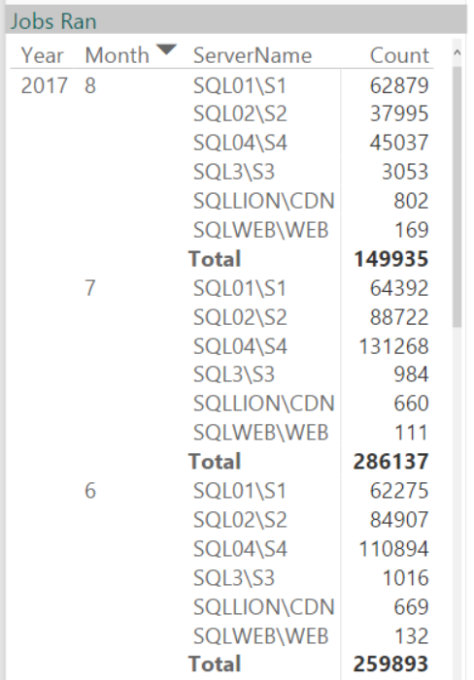
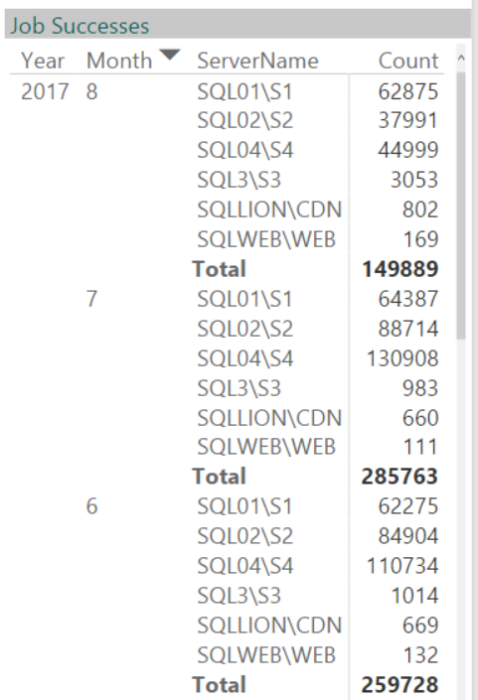
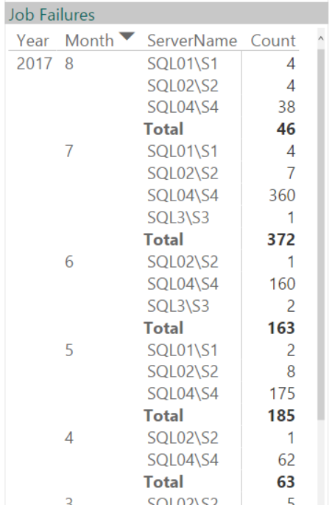
DBA SLA

Slide 36
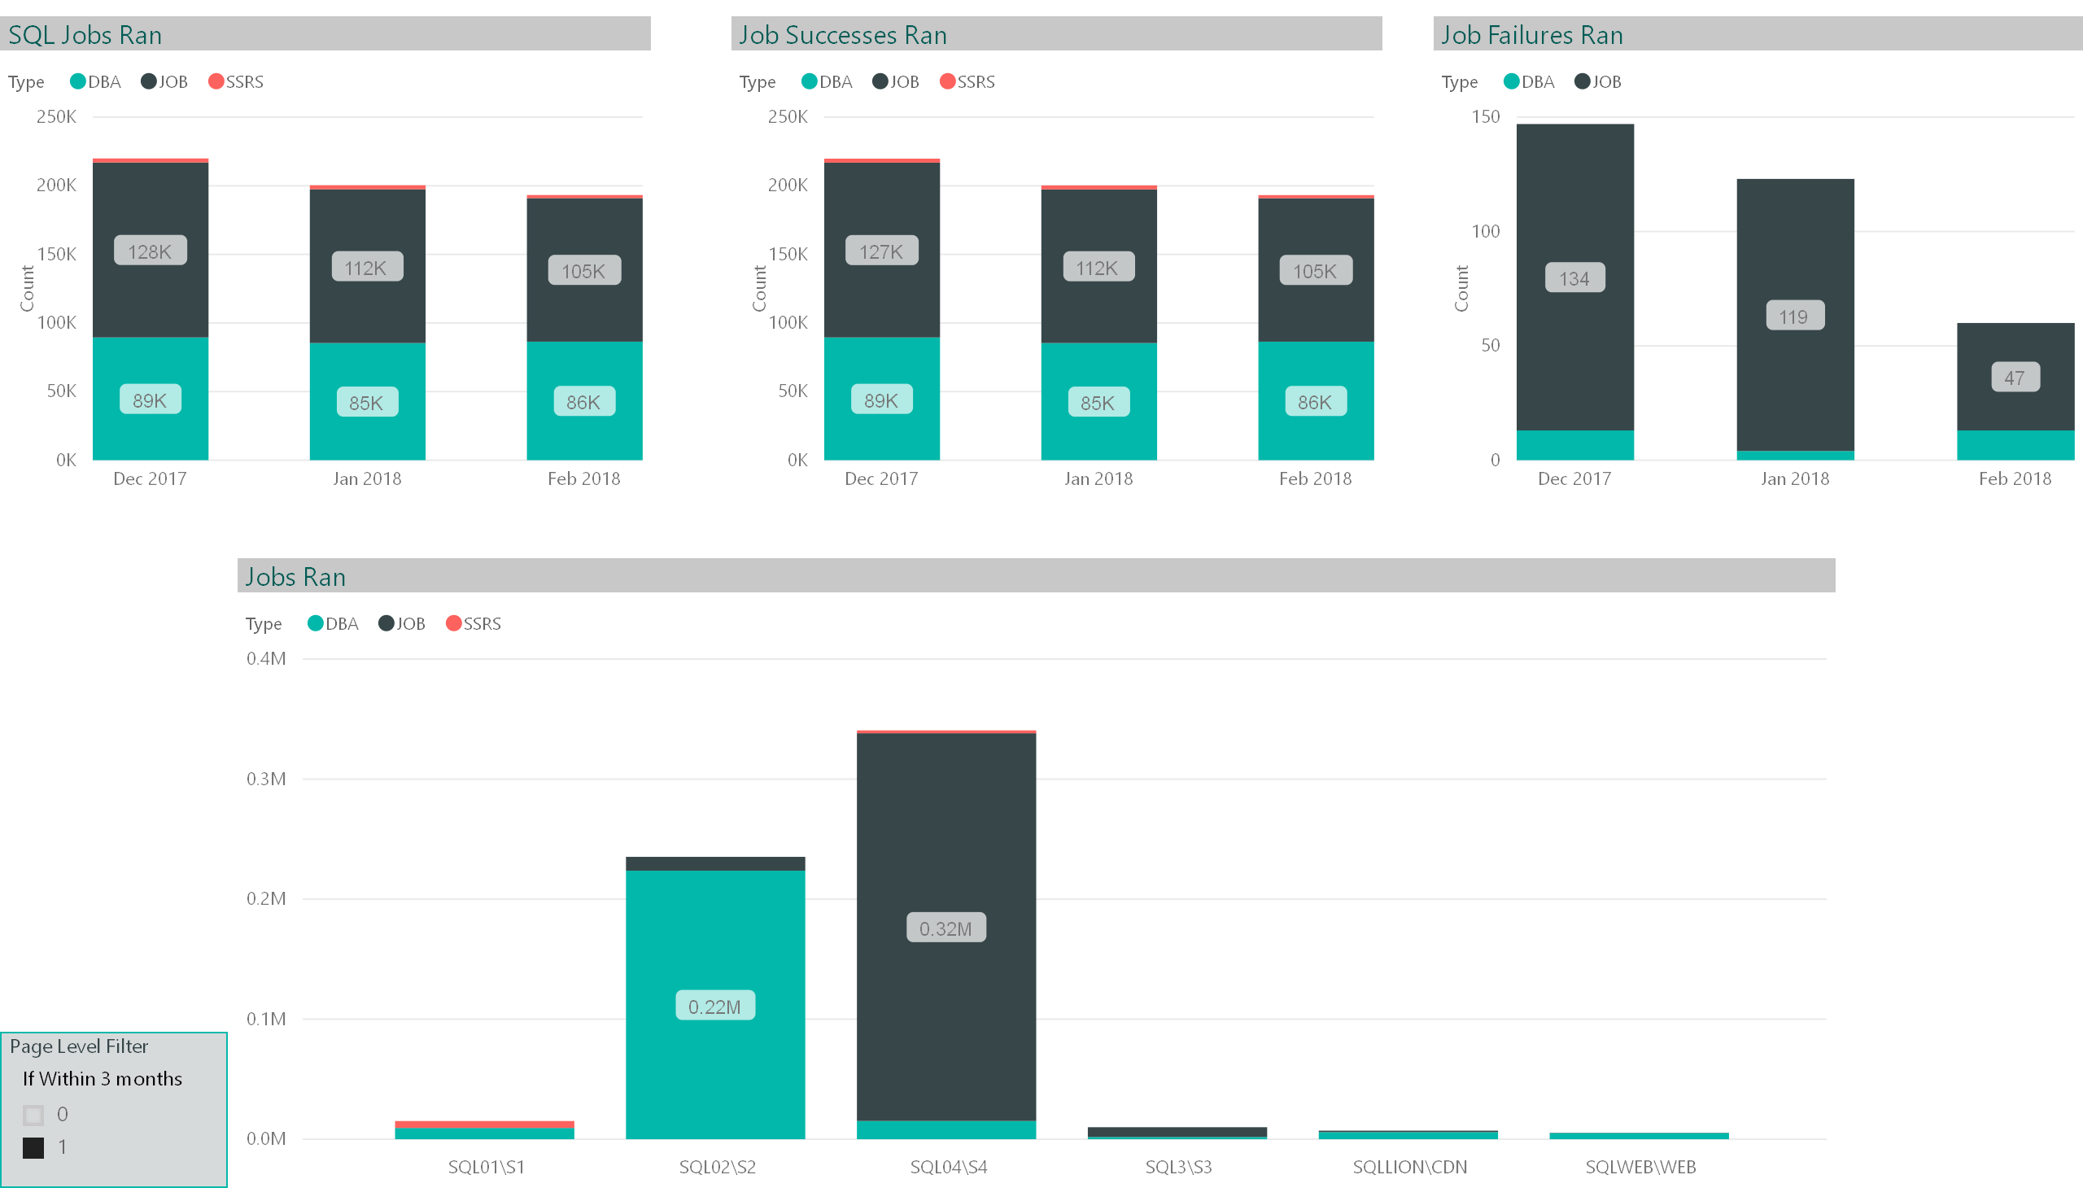

Slide 37
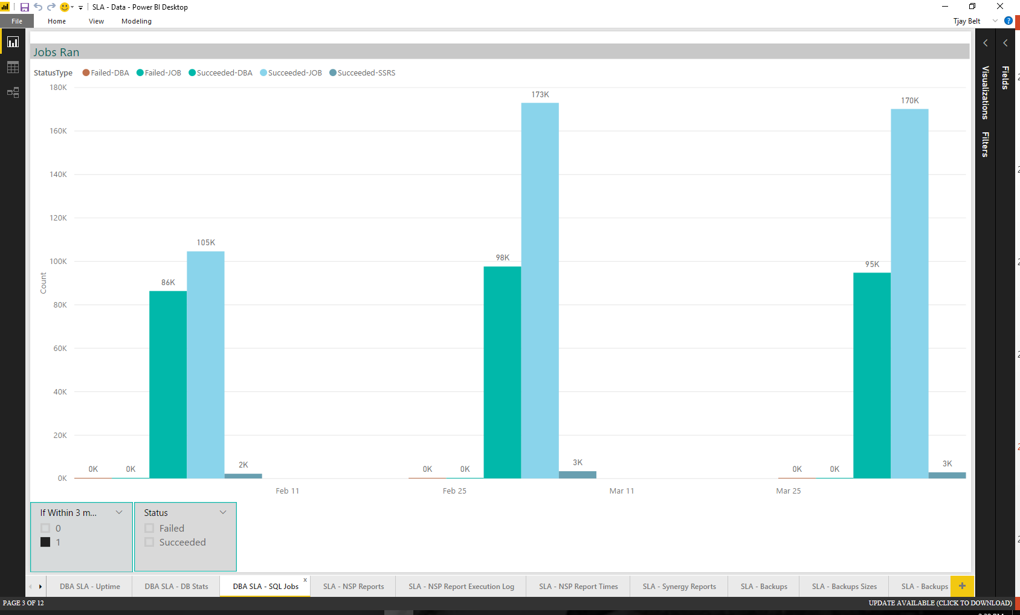
DBA SLA

Slide 38
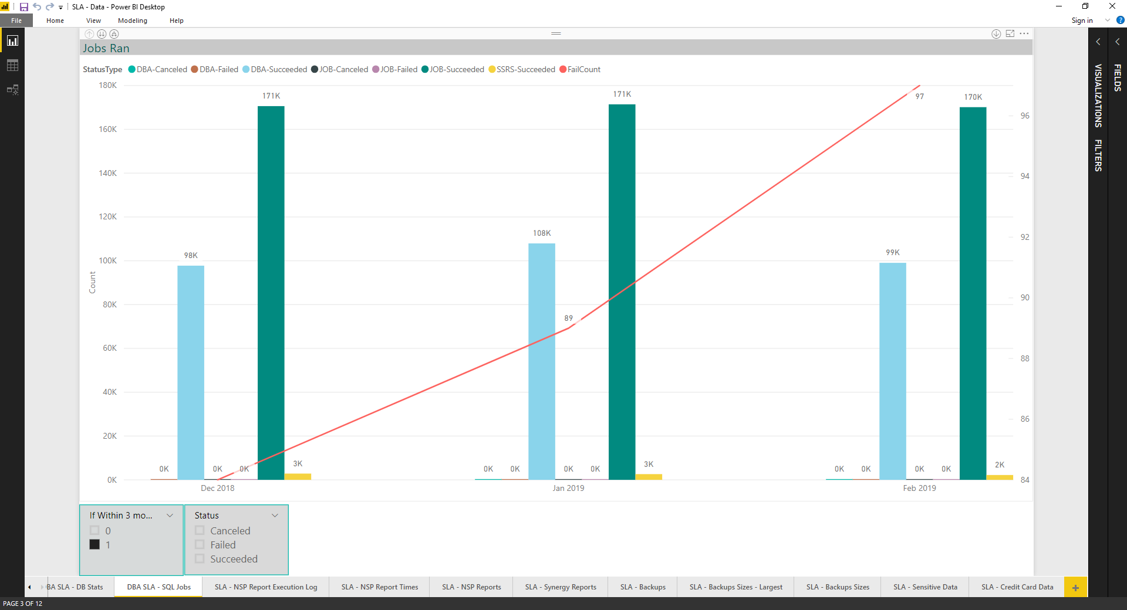

Slide 39
SLA Meeting - Report Executions

Slide 40
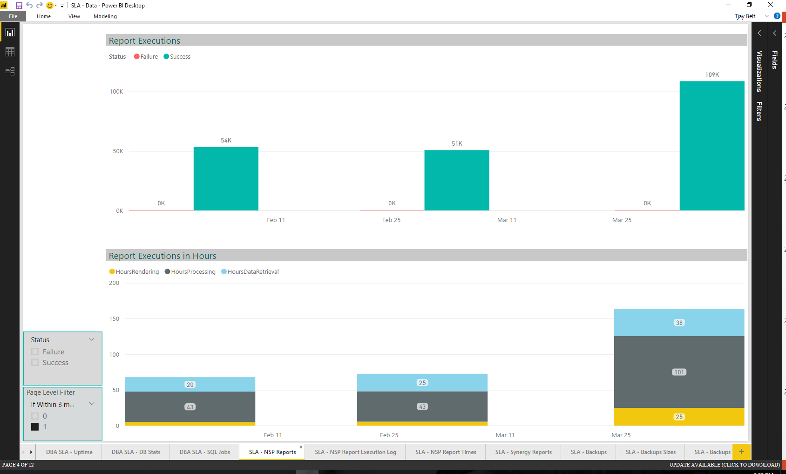
DBA SLA

Slide 41
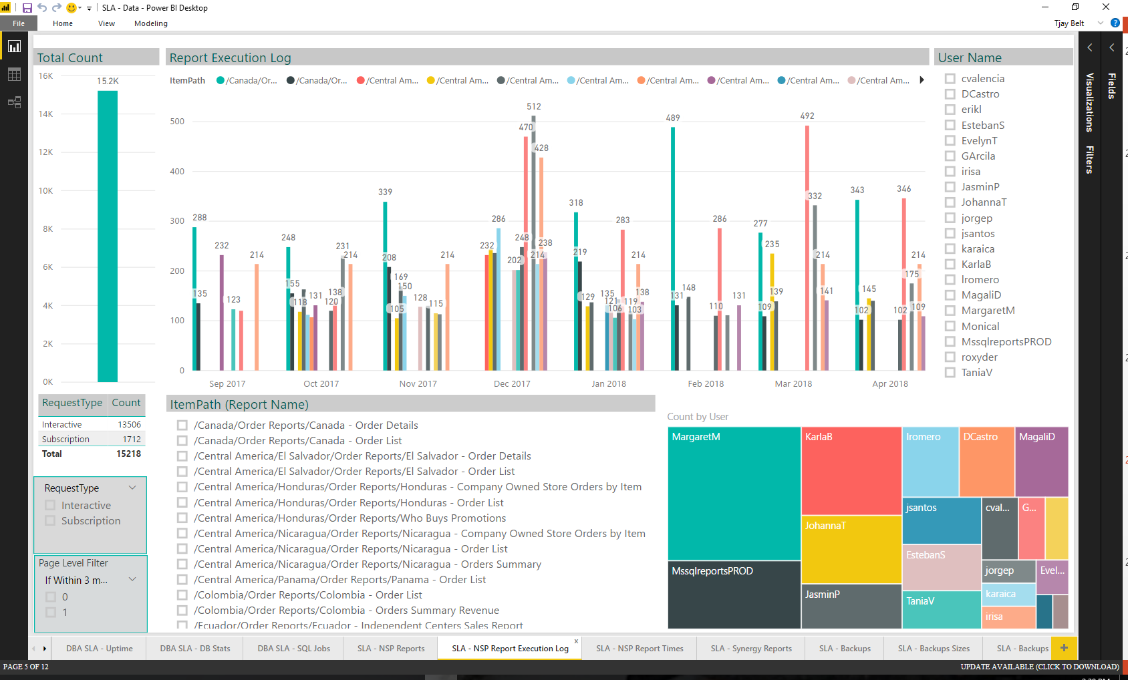
DBA SLA

Slide 42
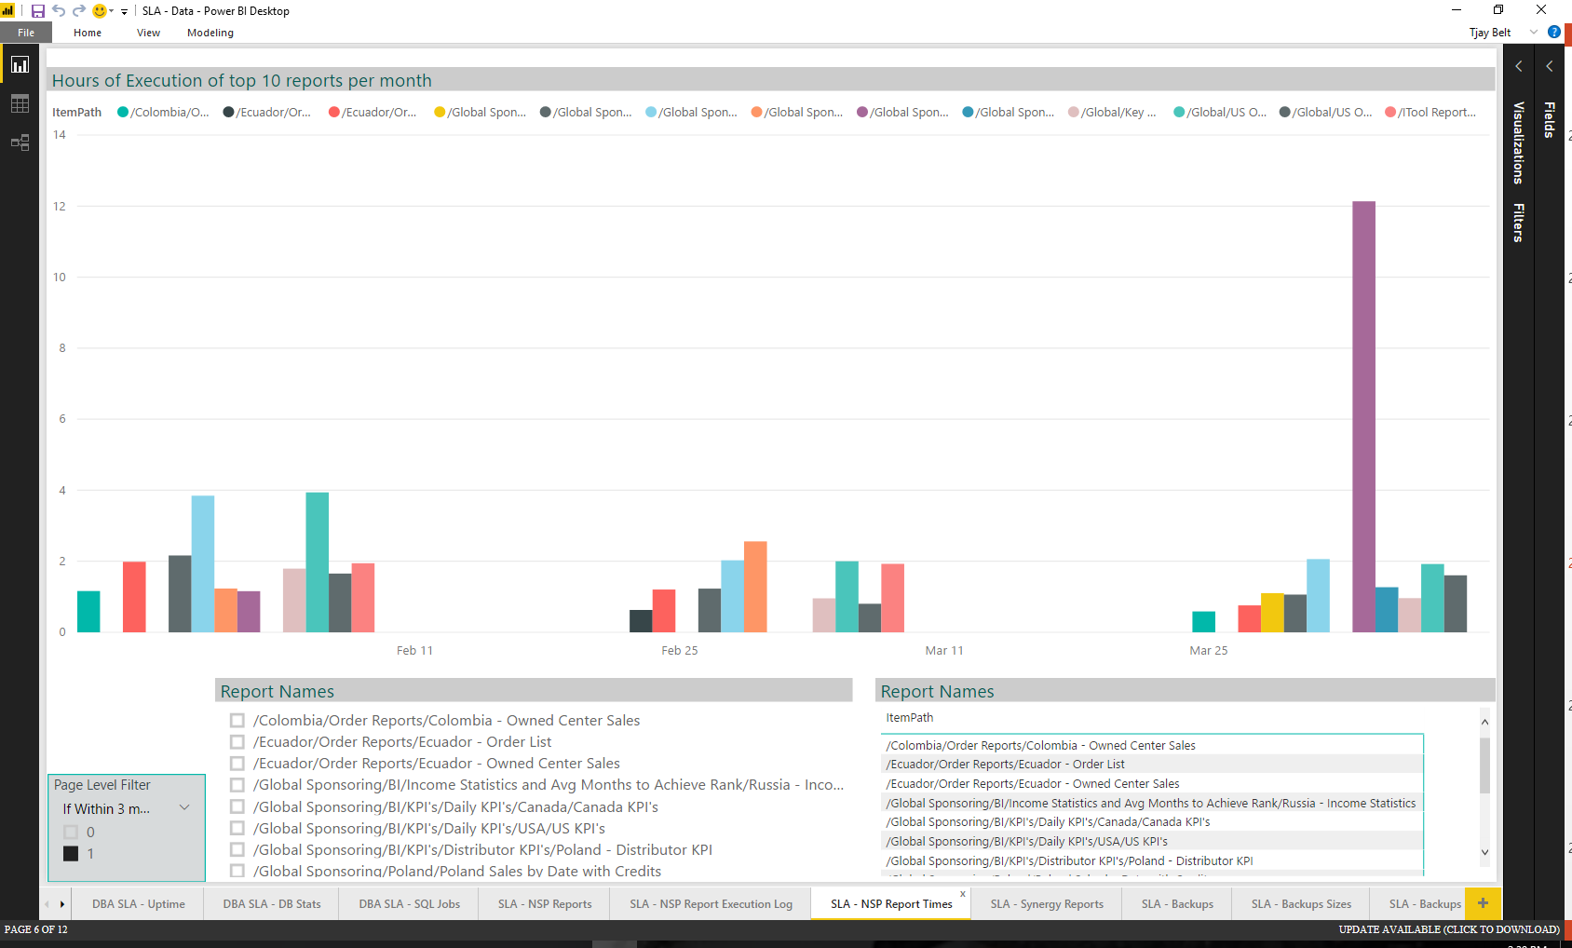
DBA SLA

Slide 43
SLA Meeting - Backups

Slide 44
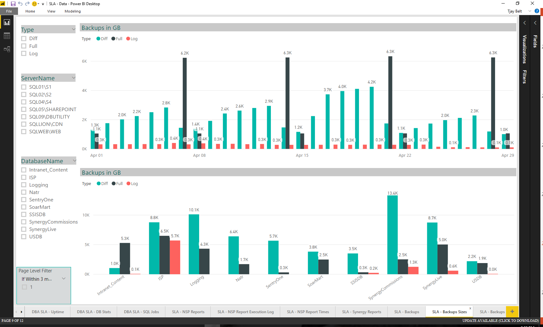
DBA SLA

Slide 45

Server Database Detail

Slide 46
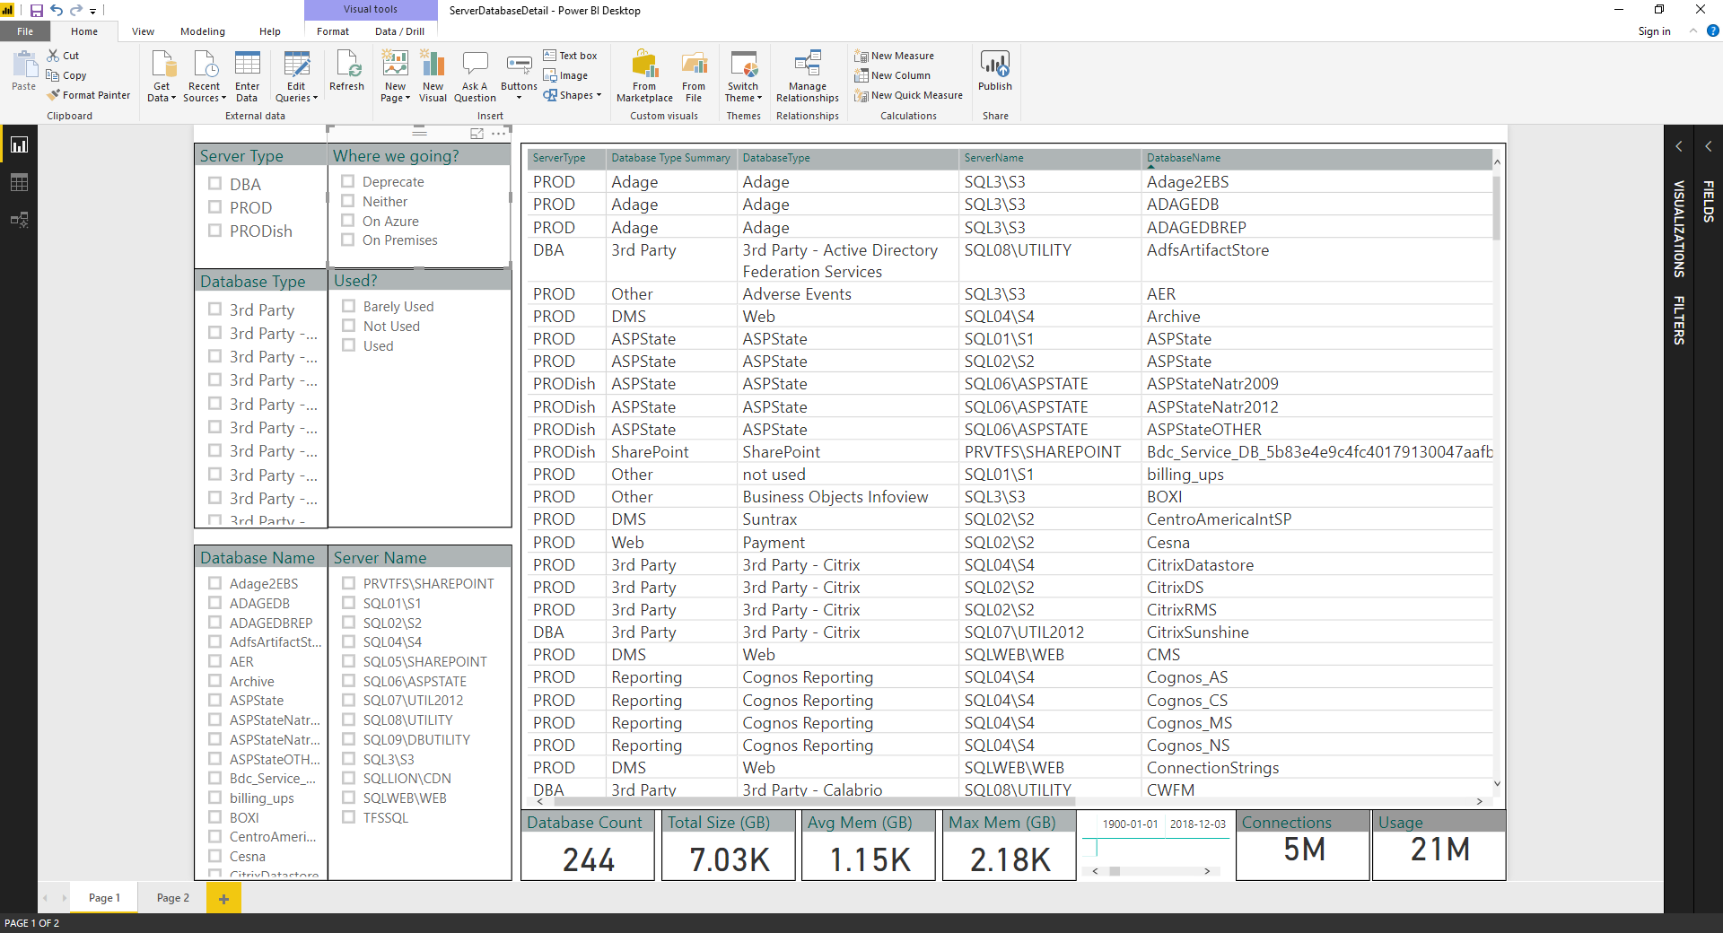

Slide 47

DDL Events

Slide 48
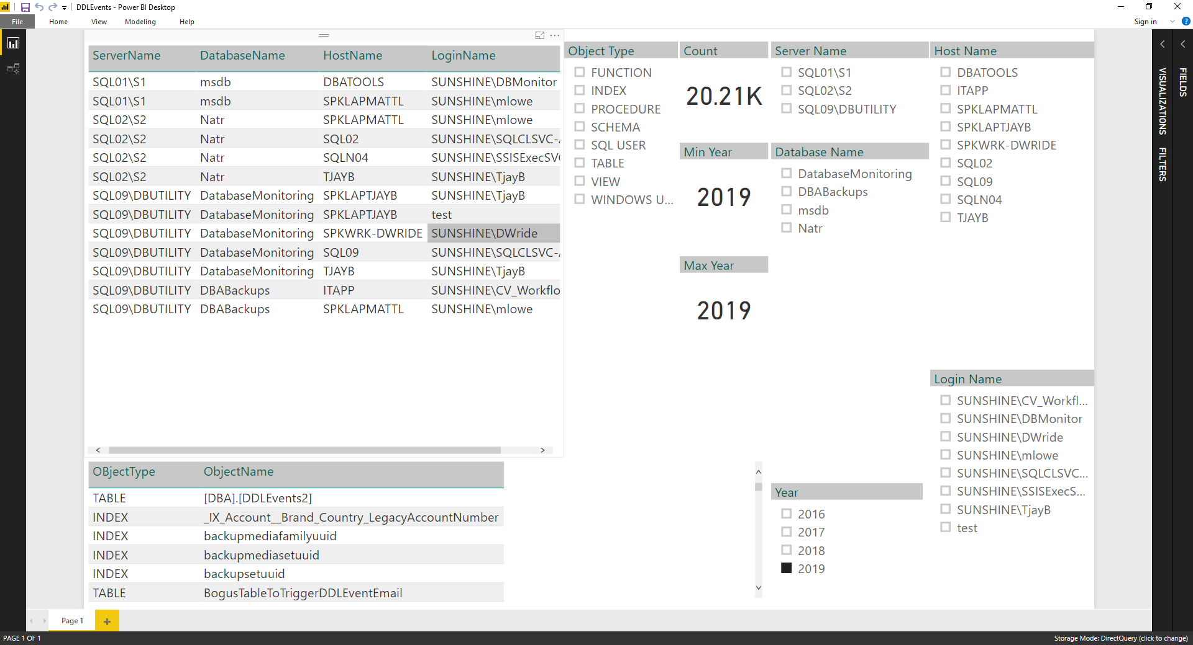

Slide 49
GPS Events

Slide 50
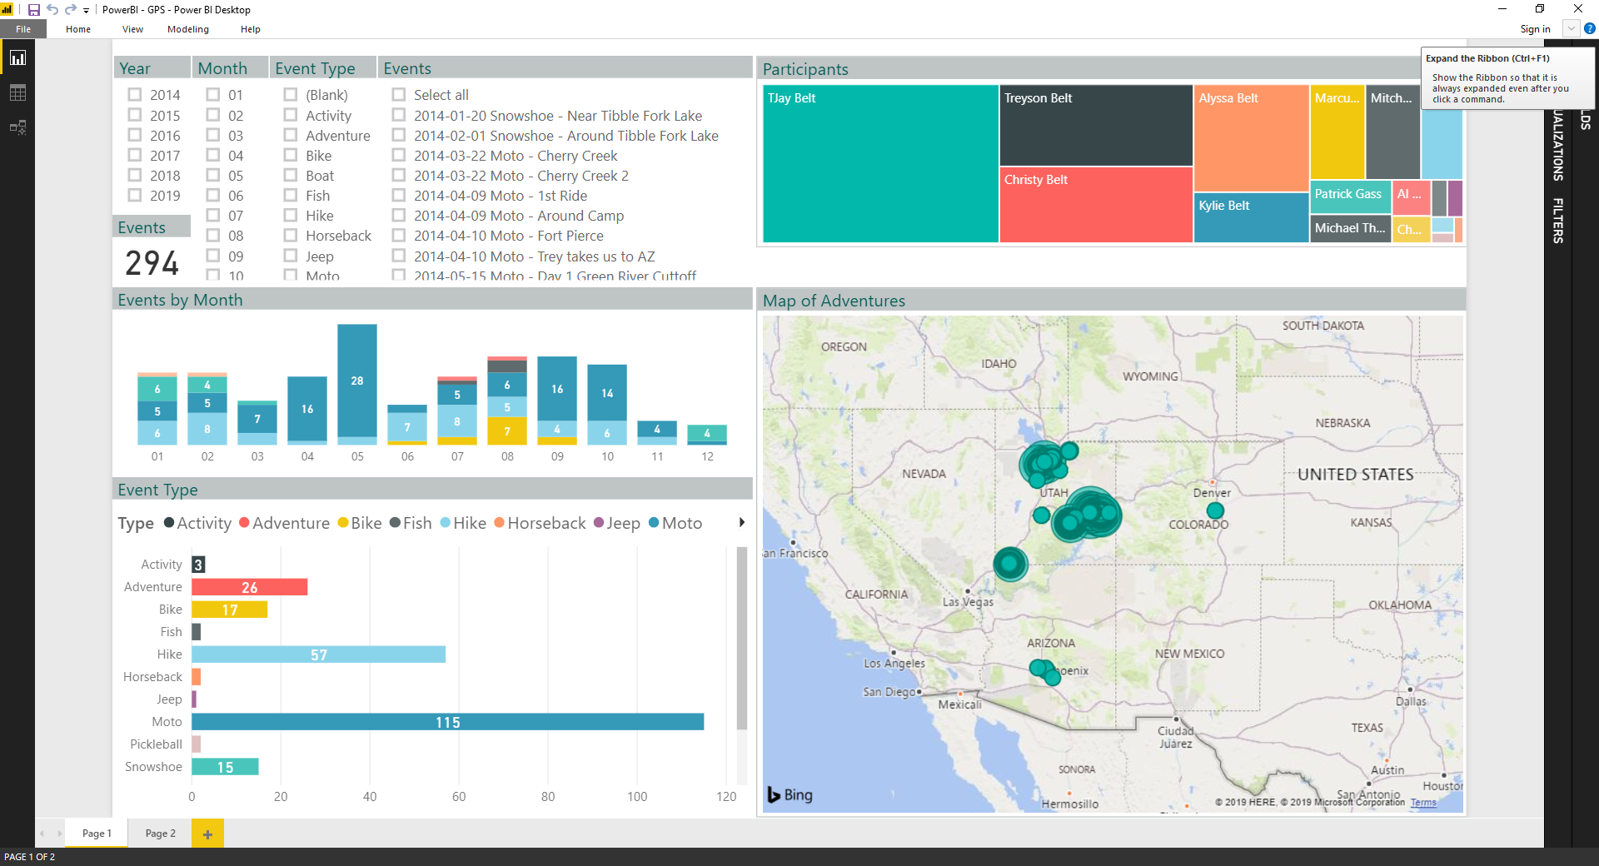

Slide 51
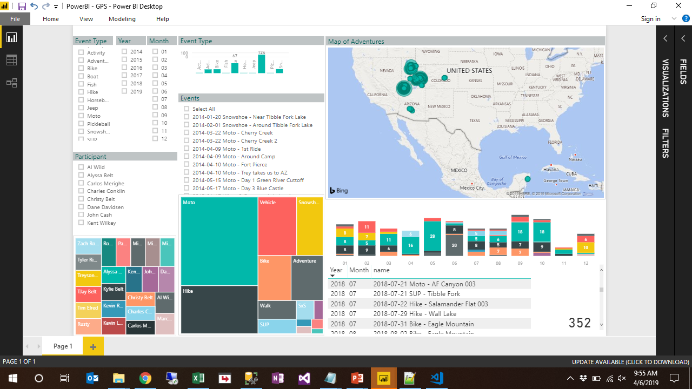

Slide 52
Thank the sponsors!!
Global Partner
Gold
Silver
Bronze
Pass
Venue

